Slide 1

driftNode
Daniel Boydstun, Matt Farich,
John McCarthy, Silas Rubinson,
Zachary Smith

Slide 2
Project Goal
Track ocean surface currents
Data collected from nodes to be used as part of a bigger robotic oceanic exploration effort

Slide 3
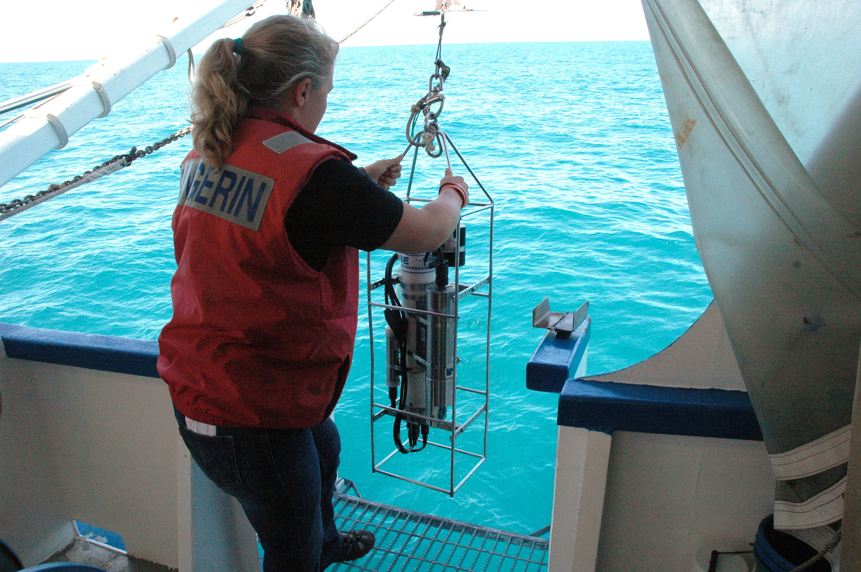
Potential Customers
Oceanographers
Would be interested in collecting data for research
*Not real people

Slide 4
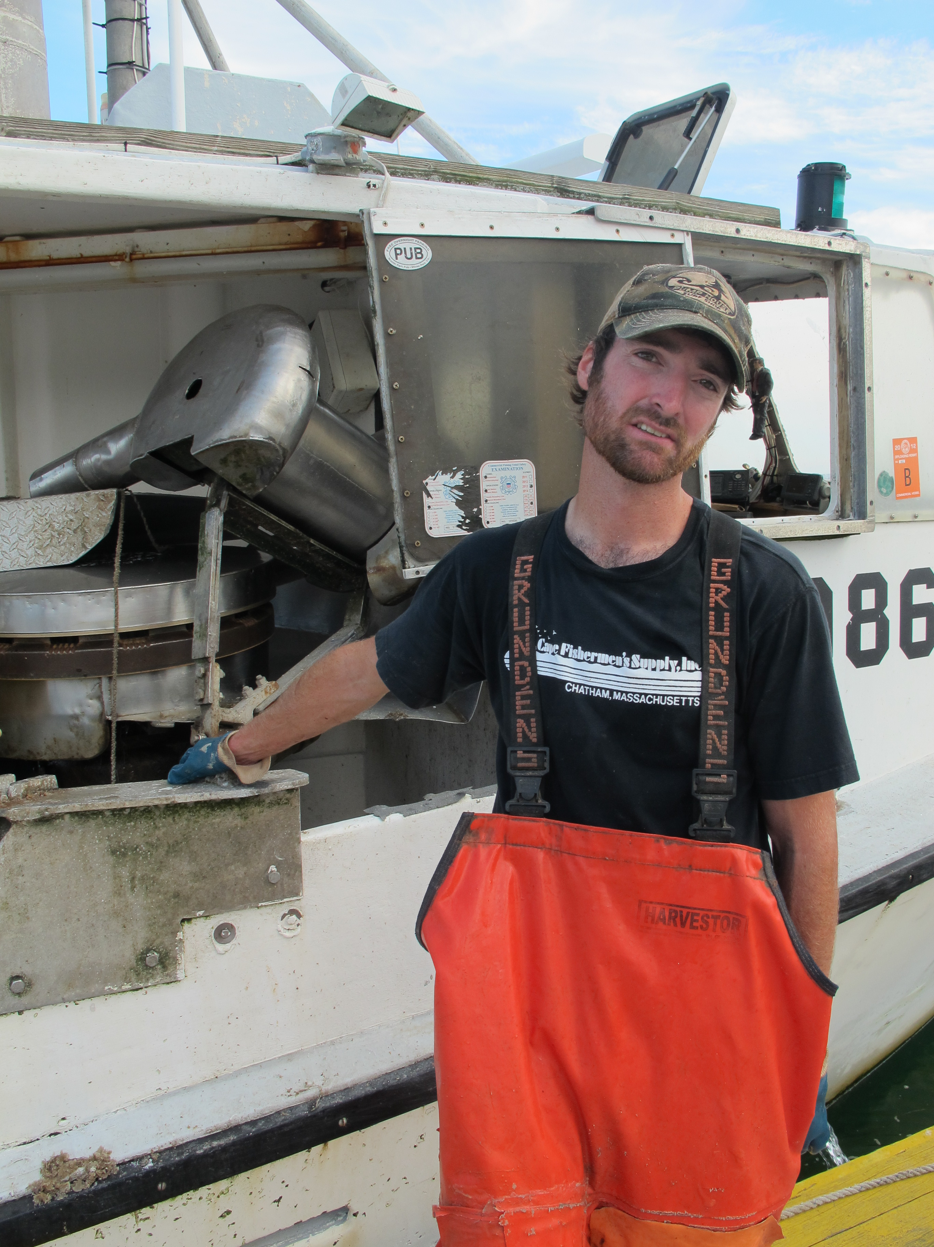
Potential Customers
Fishermen
Looking to track the locations of nets/cages as well as movements of fish
*Not real people

Slide 5
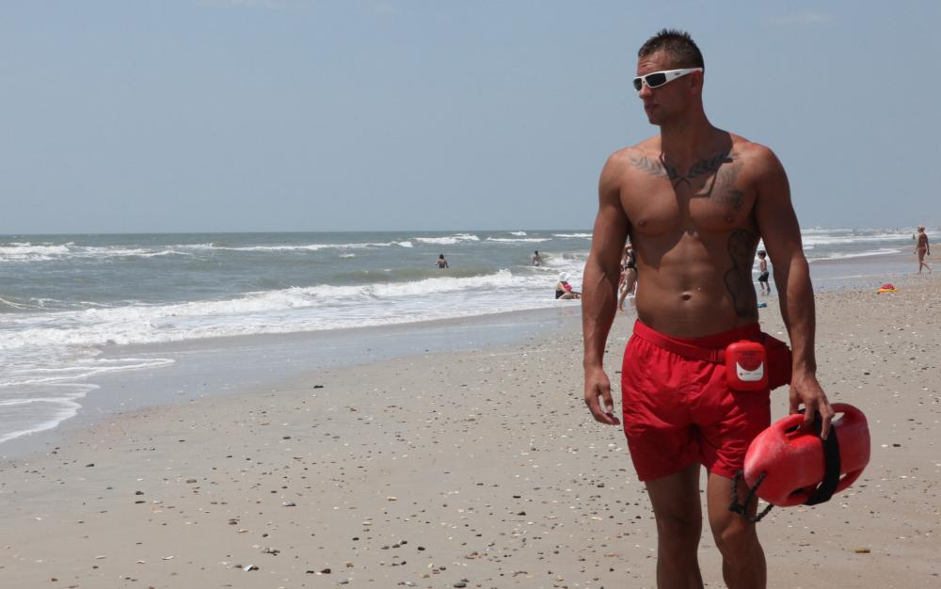
Potential Customers
Lifeguards
Would be interested in identifying currents that could be hazardous to swimmers
*Not real people

Slide 6
Functionality
Waterproof
GPS and IMU data collection at a variable frequency
Data stored locally on nodes, as well as transmitted when possible
Node intercommunication with range up to 10s of meters
At least 5 hours of battery life
Provisions for additional sensors, such as a camera
Node cluster will be modular, allowing for more nodes if desired

Slide 7
Budget
Basic Node: Total per node - $248.67
Raspberry Pi - $39.95
GPS - $39.95
Camera - $26.72
IMU - $19.95
WiFi - $8.70
Xbee - ~$50
SD Card - $9.99
Battery - ~$25
Node Casing - ~$25
Wires - $3.41

Slide 8
Budget
Master Node: Total price node - $682.14
NVIDA Jetson - $192.99
GPS - 39.95
GPS Antenna - $12.95
IMU - $400.57
Wi-Fi - $19.99
SD Card - 15.96
Battery - ~$40
Node Casing - ~$40
Xbee - ~$50

